Slide 1
Data Analysis: Senseable Construction
Measuring Air Quality around High rise Construction
WP 3.4
22-8-2023
Miny Rajiv

Slide 2
Research Set-Up

Slide 3
Goals
Measure the concentration of air pollutants (PM2.5, NO2, UFP, BC), to: 1. Understand the average concentrations for different construction activities 2. See if bio-based or electric building has a higher concentration reduction impact

Slide 4
2 case studies
1. Switi: Bio-based, non-electric
2. POST: Conventional, electric
Nb. * All in building phase * Initially, a third case was included (Sawa: Bio-based & electric). But they only started the building phase after the study had been conducted

Slide 5
Sampling process
Measurement frequency: 5 measurements per site, 10 total. Of which 1 day without activity.
Points of measurement: - Trucks - Main activities including crane
Time of measurement: early mornings ~6.30-11.30

Slide 6
Cases

Slide 7
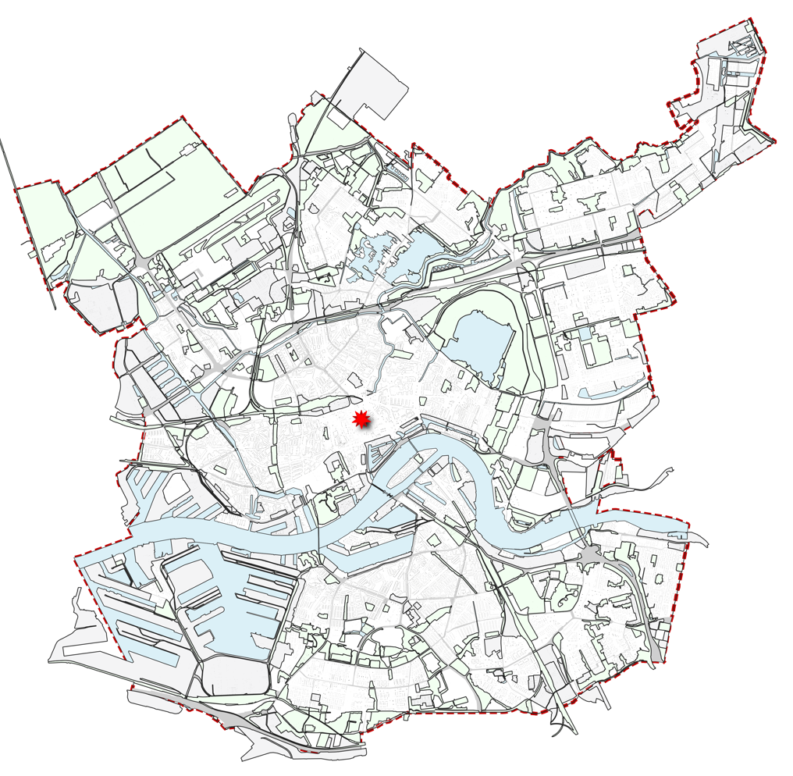
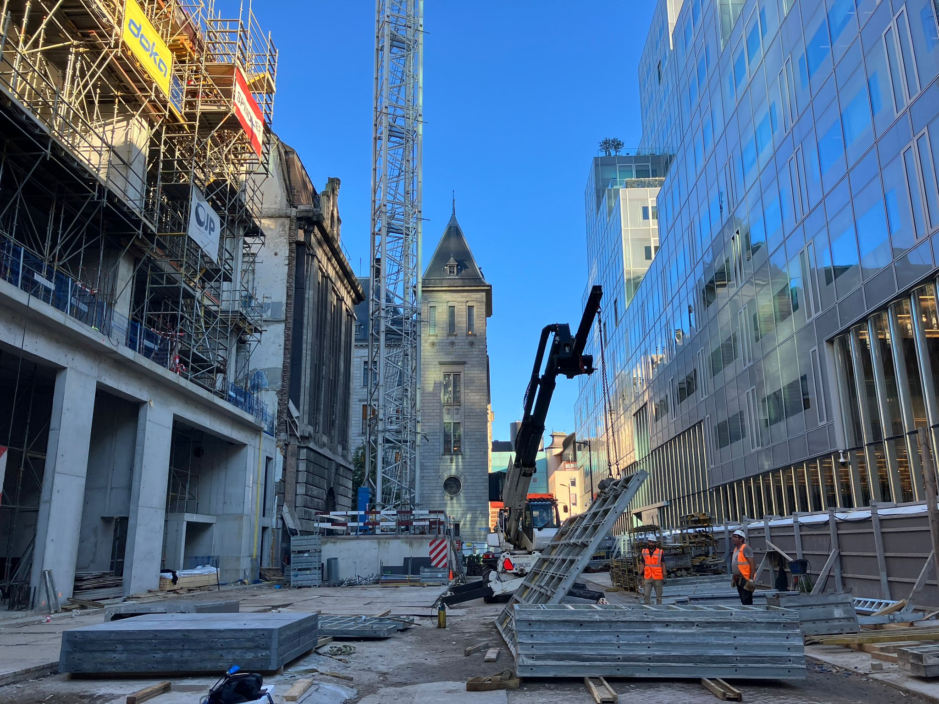
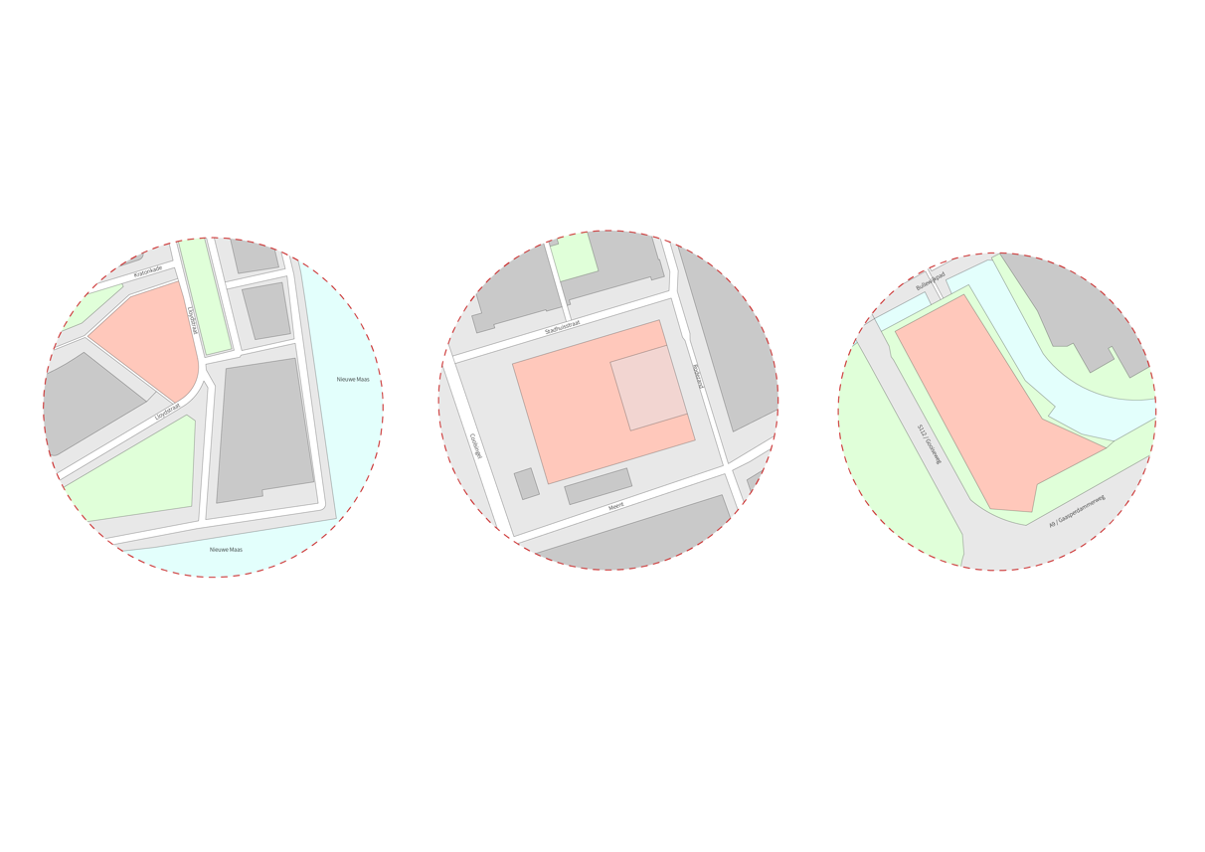
Case Study 1: Post Rotterdam Conventional construction, with electric crane
The Post Rotterdam project located in the city centre of Rotterdam. It is a mixed high-rise building built with a conventional steel and concrete structure.
Expected dates: 2022 -January 2025.

Slide 8
Case overview - POST
POST is a multifunctional concept with hotel, appartments, bars, restaurants and retail. It is located in the middel of the city centre of Rotterdam, next to the coolsingel and the city hall.
Building phase: During the period of measuring, they were building the 2-5th floor of the building.
Activities include cement mixing, driving up and down with a small truck, drilling and using an electric crane for carrying and placing materials.

Slide 9
Case overview – Switi
Switi is a residential middle-rise building made of wood. It is located in Amsterdam South-East.
Building phase: During the period of measuring, they were building the 1-5th floor of the building.
Activities include (1-2) weekly delivery of materials, drilling and using a diesel-agregated crane for carrying and placing materials.

Slide 10
Results

Slide 11
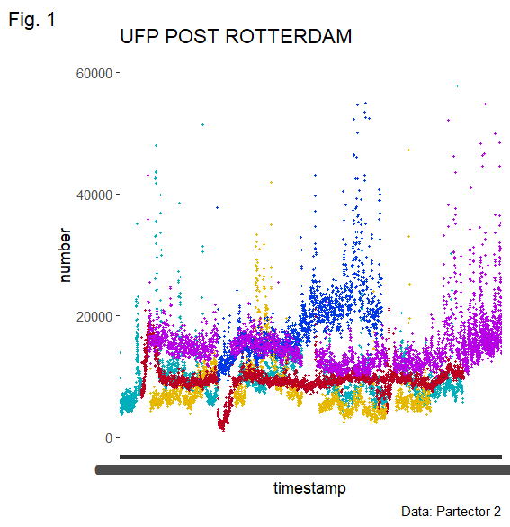
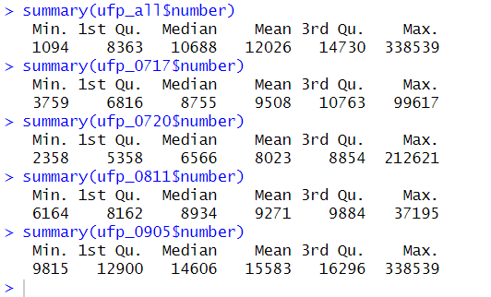
Overview UFP – POST
Location: Post, Rotterdam
Days: 17 July, 20 July, 10 August, 14 August, 9 September
Instrument: Partector 2
Plot: Numbers of particles UFP
Min | 1st Quartile | Median | Mean | 3rd Quartil | Max
1094 | 8363 | 10688 | 12026 | 14730 | 338539
Notes:
Chop up in chunks per location. Look at break periods!!

Slide 12
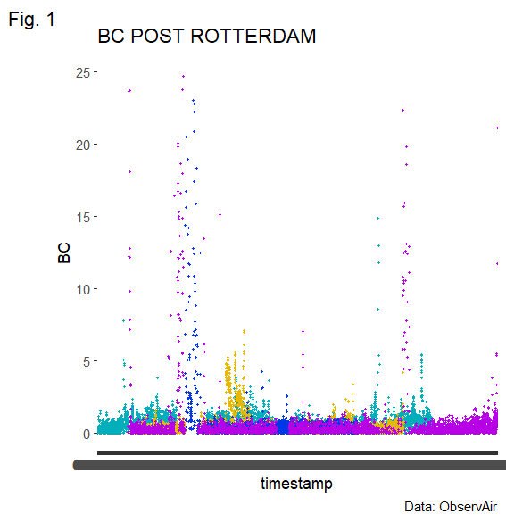
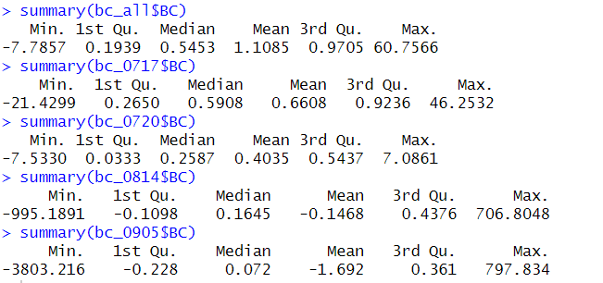
Overview BC – POST
Location: Post, Rotterdam
Days: 17 July, 20 July, 10 August, 9 September
Instrument: ObservAir
Plot: BC particles
Notes:
Zoom in on the spikes. Align ultrafines + BC temporaliy (see if there are spikes).

Slide 13
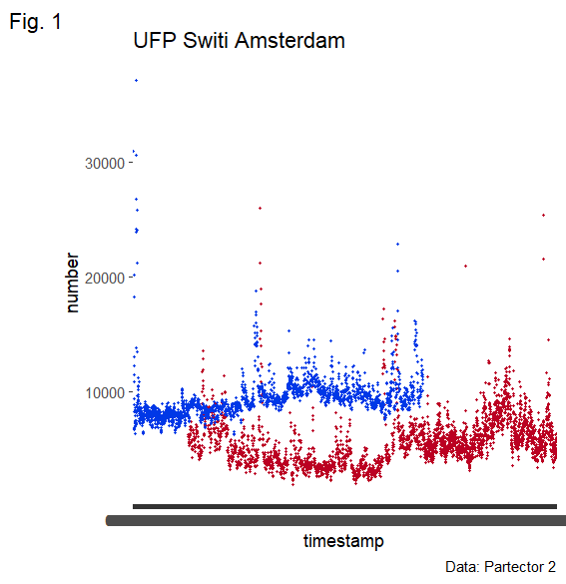
Overview UFP – Switi
Location: Post, Rotterdam
Days: 12 July (?), 14 July (?), 21 July, 11 August
Instrument: Partector 2
Plot: Numbers of particles UFP
Notes:
Look at magnitude of spikes. (look in there). Look at ratio of the two.

Slide 14
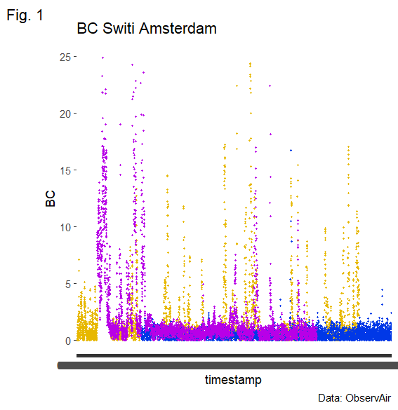
Overview BC – Switi
Location: Post, Rotterdam
Days: 12 July (?), 14 July, 21 July, 11 August
Instrument: ObservAir
Plot: BC particles
Notes:
See if the spikes match with what I observed!! Create table. Peak – background table (number the events. Characterize it).

Slide 15
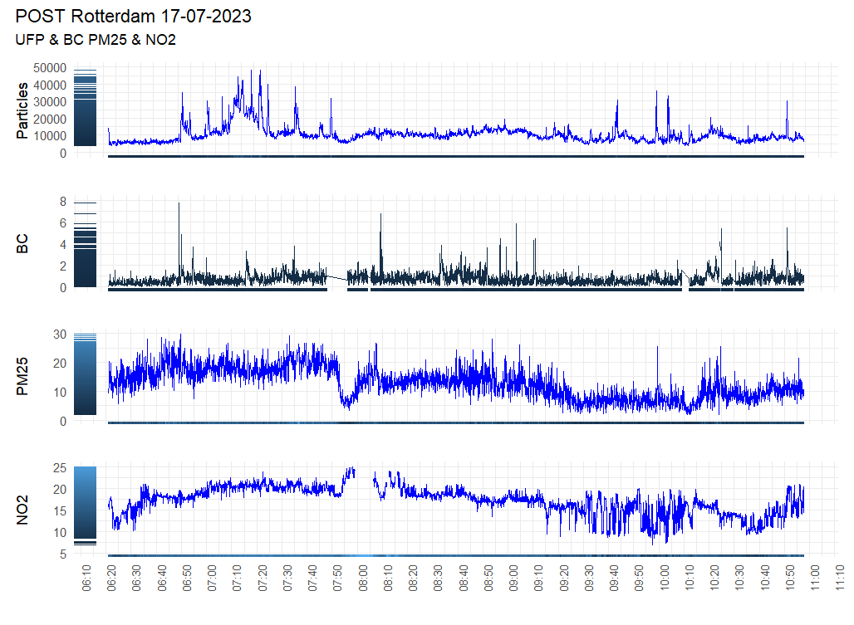
17-July-2023 - Post
Location: Post, Rotterdam
Wind: 3/4 – South-West
Temp: 22
Instrument: DST, Partector 2, CS
Plot: PM25, NO2, UFP, BC

Slide 16
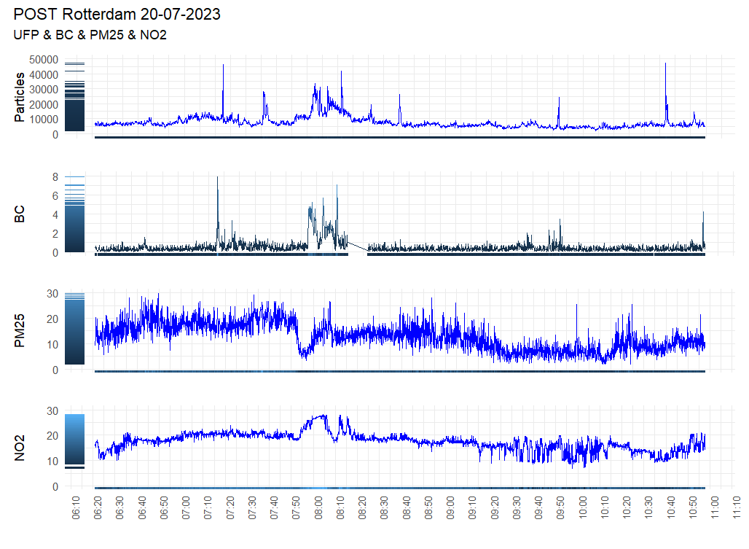
20-July-2023 - Post
Location: Post, Rotterdam
Wind: Speed: 1, direction: North-West Temp: 22
Instrument: DST, Partector 2, CS
Plot: PM25, NO2, UFP, BC

Slide 17
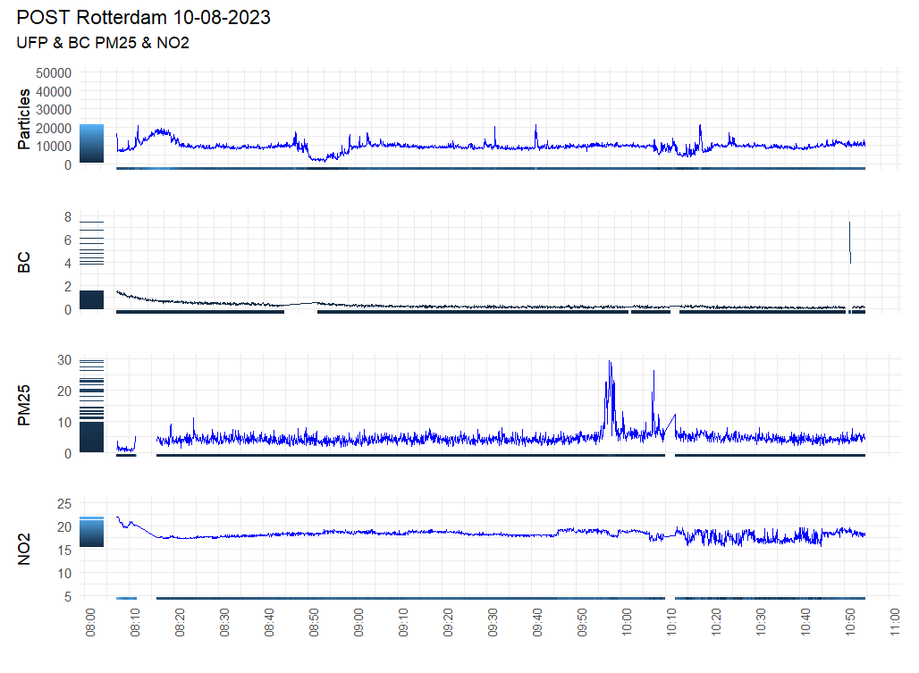
10-August-2023 – Post – No Construction
Location: Post, Rotterdam
Wind: Speed: 1, Direction: South
Temp: 25
Instrument: Partector 2, CS
Plot: PM25, NO2, UFP,

Slide 18
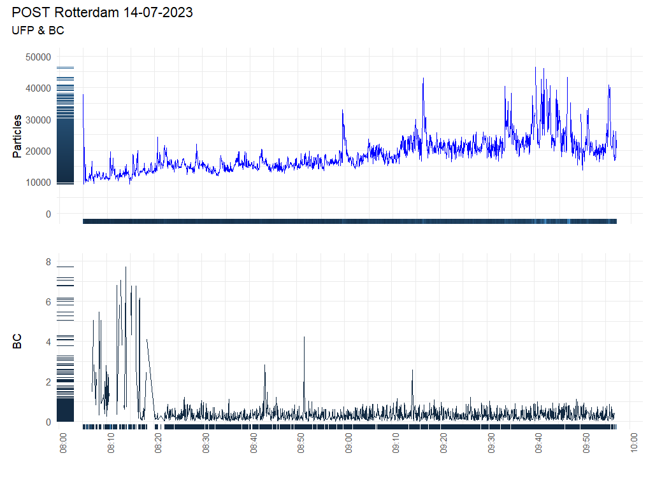
14-August-2023 – Post – Almost no construction
Location: Post, Rotterdam
Wind: Speed: 2 , Direction: South-East
Temp: 22
Instrument: DST, Partector 2
Plot: UFP, BC

Slide 19
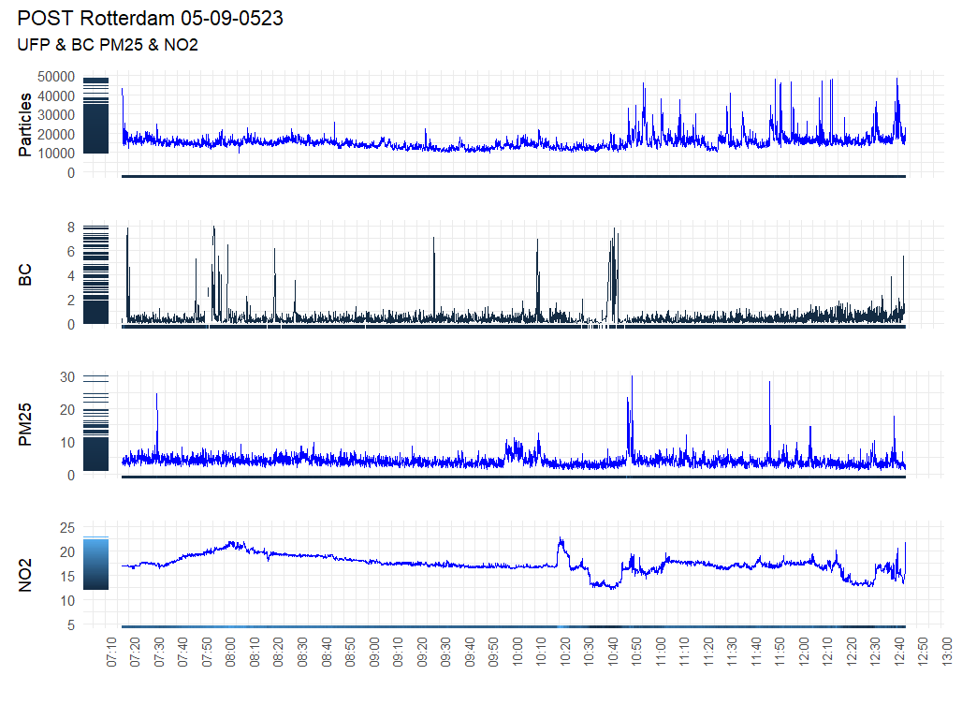
5-Sept-2023 – Post – Onsite
Location: Post, Rotterdam
Wind: Speed 2, Direction East
Temp: 29
Instrument: DST, Partector 2, CS
Plot: PM25, NO2, UFP, BC
Notes:
PM10 as well.

Slide 20
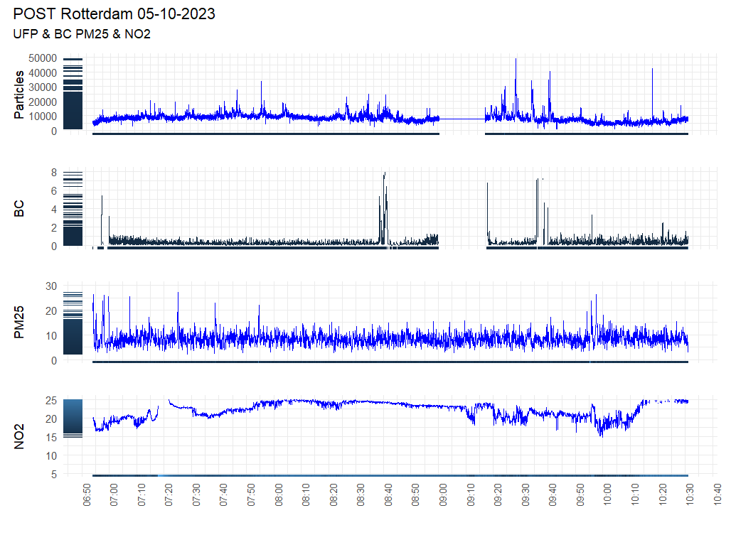
5-Oct-2023 – Post – Onsite (mostly)
Location: Post, Rotterdam
Wind: SpeedX, Direction X
Temp: 22
Instrument: DST, Partector 2, CS
Plot: PM25, NO2, UFP, BC
Notes:
PM10 as well.

Slide 21
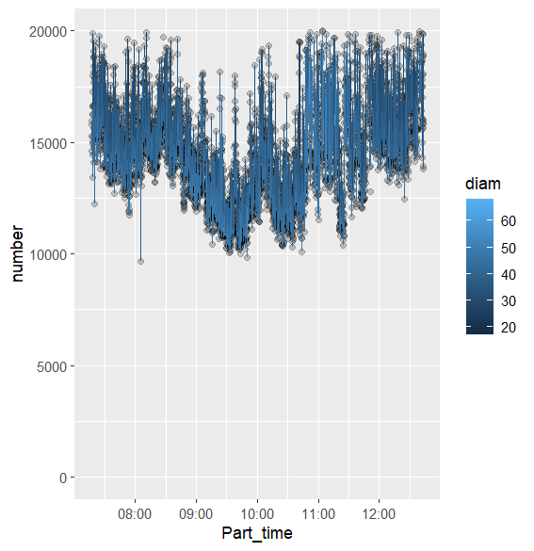
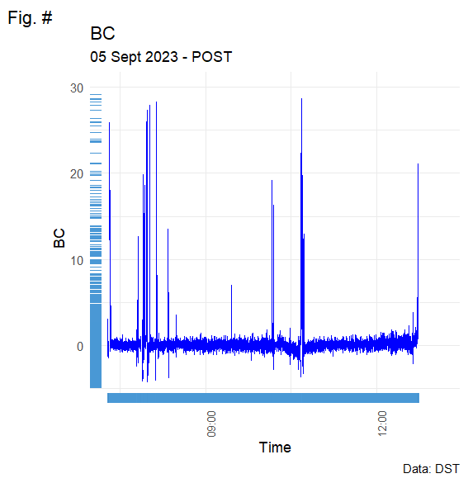
Zoomed in
5-Sept-2023 - Post

Slide 22
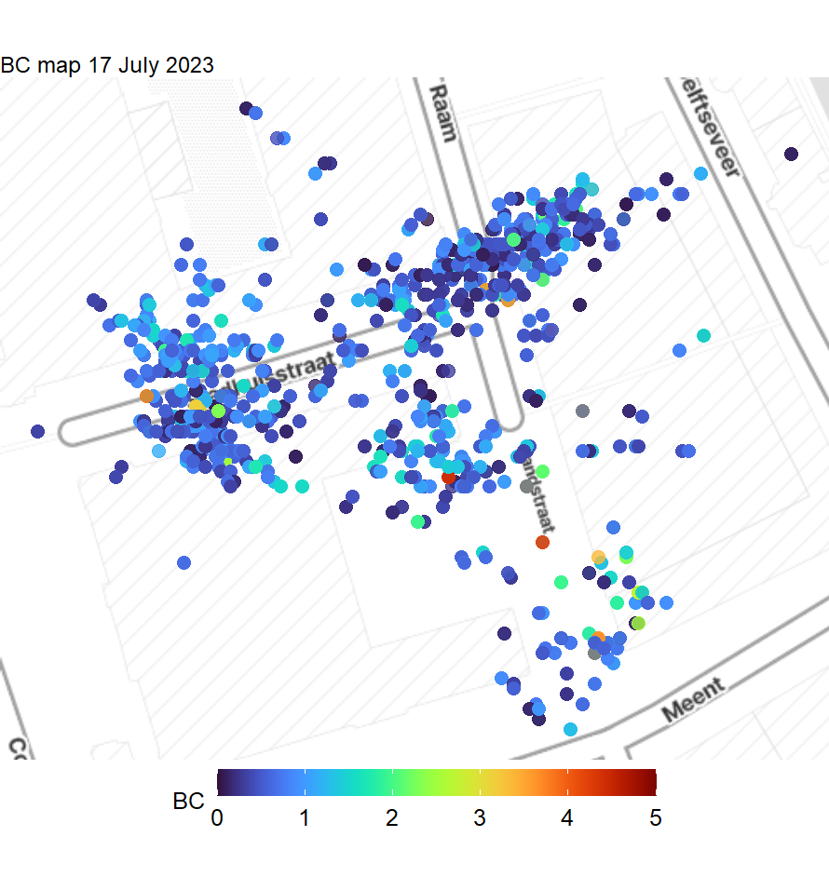
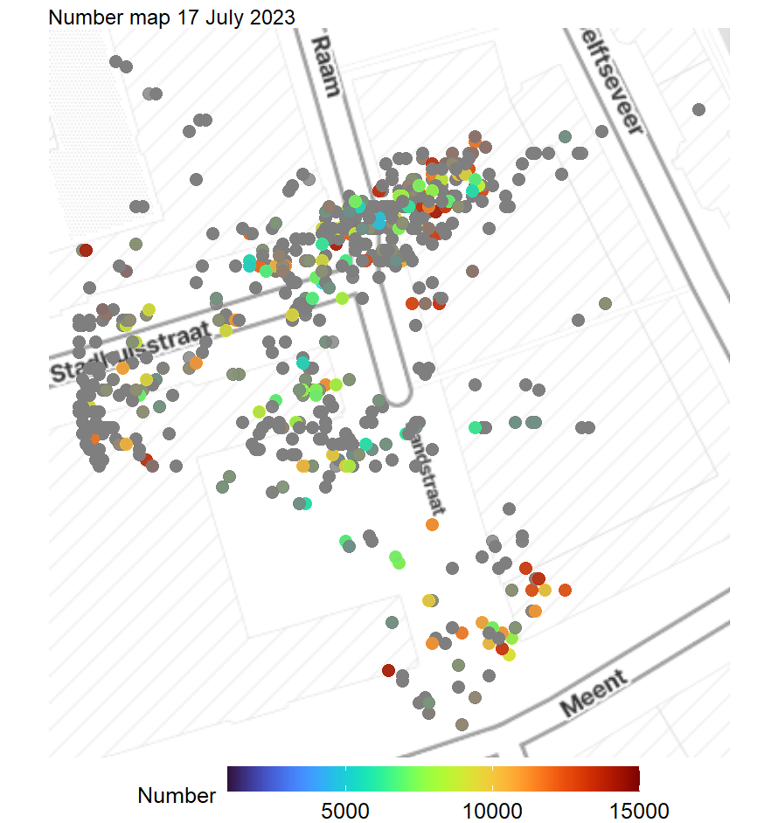
17-July-2023 - Post

Slide 23
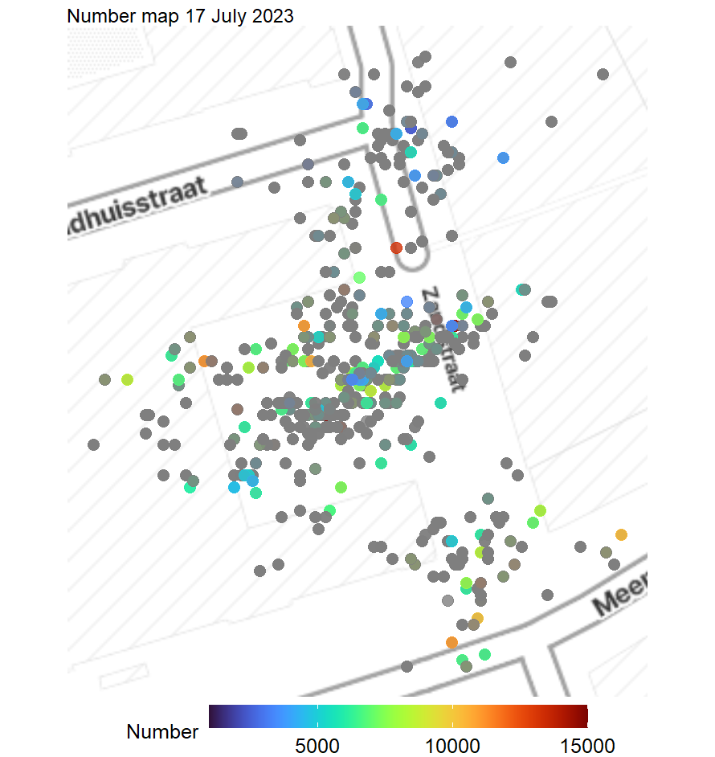
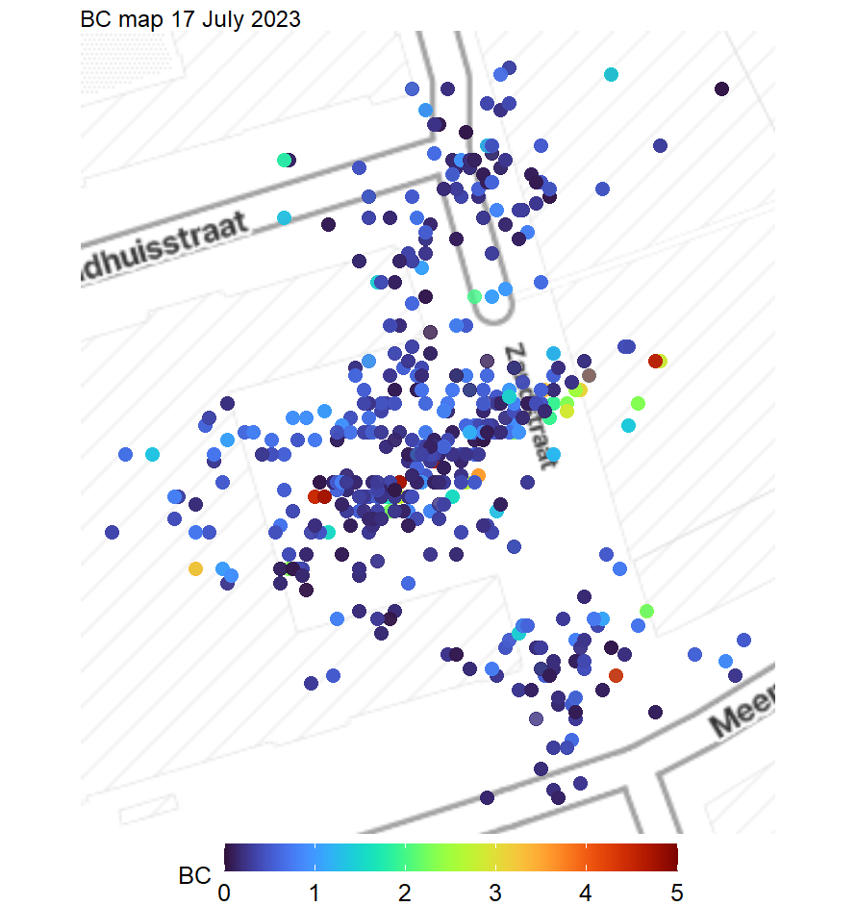
20-July-2023 - Post
Location: Post, Rotterdam
Wind: Speed: 1, direction: North-West
Temp: 22
Instrument: DST, DST2, Partector 2
Plot: PM25, NO2, UFP, BC

Slide 24
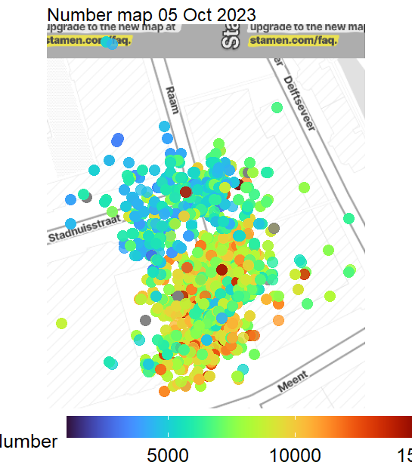
05-Oct-2023 - Post

Slide 25
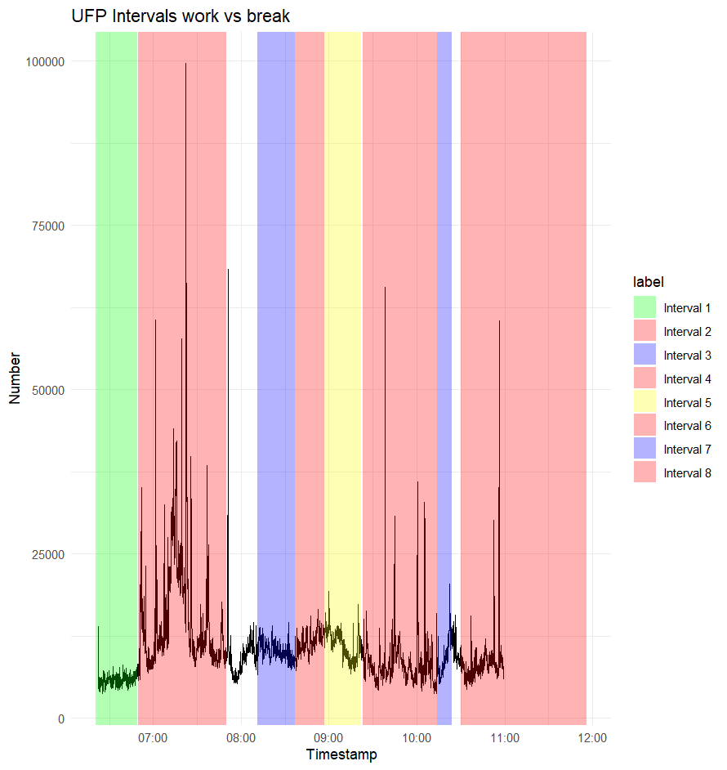
17-July-2023 – Post - Breaks
 | start | end | mean_value_UFP | mean_value_BC
1 | 17-7-2023 06:49 | 17-7-2023 08:49 | 588.578.855.721.393 | 0.389252144469526
2 | 17-7-2023 07:50 | 17-7-2023 09:50 | 152.062.419.533.851 | 0.794564643488509
3 | 17-7-2023 08:37 | 17-7-2023 10:37 | 10.291.084.398.977 | 0.808701221166893
4 | 17-7-2023 08:57 | 17-7-2023 10:57 | 115.461.528.239.203 | 104.319.423.791.822
5 | 17-7-2023 09:22 | 17-7-2023 11:22 | 111.850.691.489.362 | 0.643151138088012
6 | 17-7-2023 10:14 | 17-7-2023 12:14 | 841.461.227.154.047 | 0.529150244698206
7 | 17-7-2023 10:24 | 17-7-2023 12:24 | 955.878.145.695.364 | 0.867178021978022
8 | 17-7-2023 11:56 | 17-7-2023 13:56 | 832.540.362.811.791 | 0.855183289124668

Slide 26
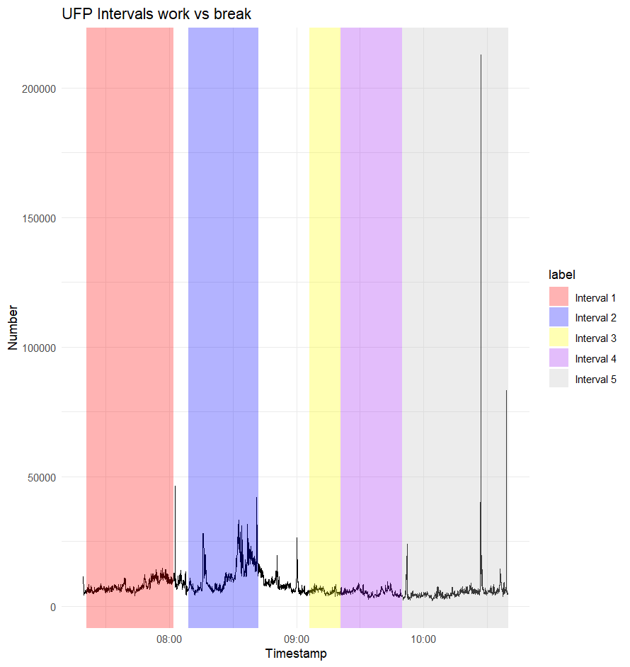
20-July-2023 – Post – Breaks
 | start | end | mean_value_UFP
1 | 20-7-2023 07:21 | 20-7-2023 08:02 | 78.995.487.012.987
2 | 20-7-2023 08:09 | 20-7-2023 08:42 | 122.076.088.709.677
3 | 20-7-2023 09:06 | 20-7-2023 09:21 | 578.967.699.115.044
4 | 20-7-2023 09:21 | 20-7-2023 09:50 | 533.034.633.027.523
5 | 20-7-2023 09:50 | 20-7-2023 10:40 | 568.620.214.190.094

Slide 27
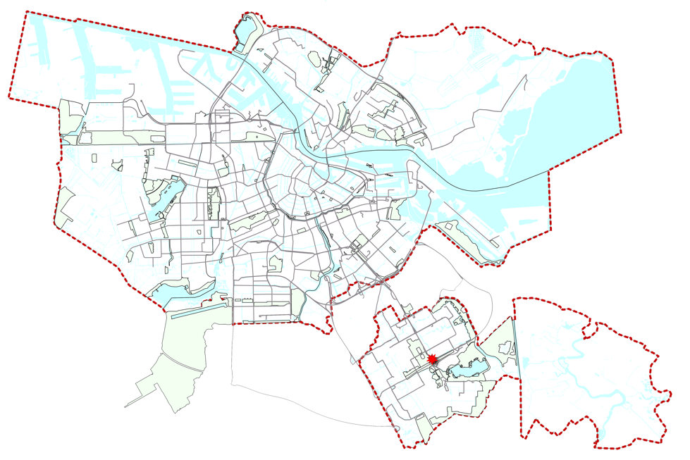
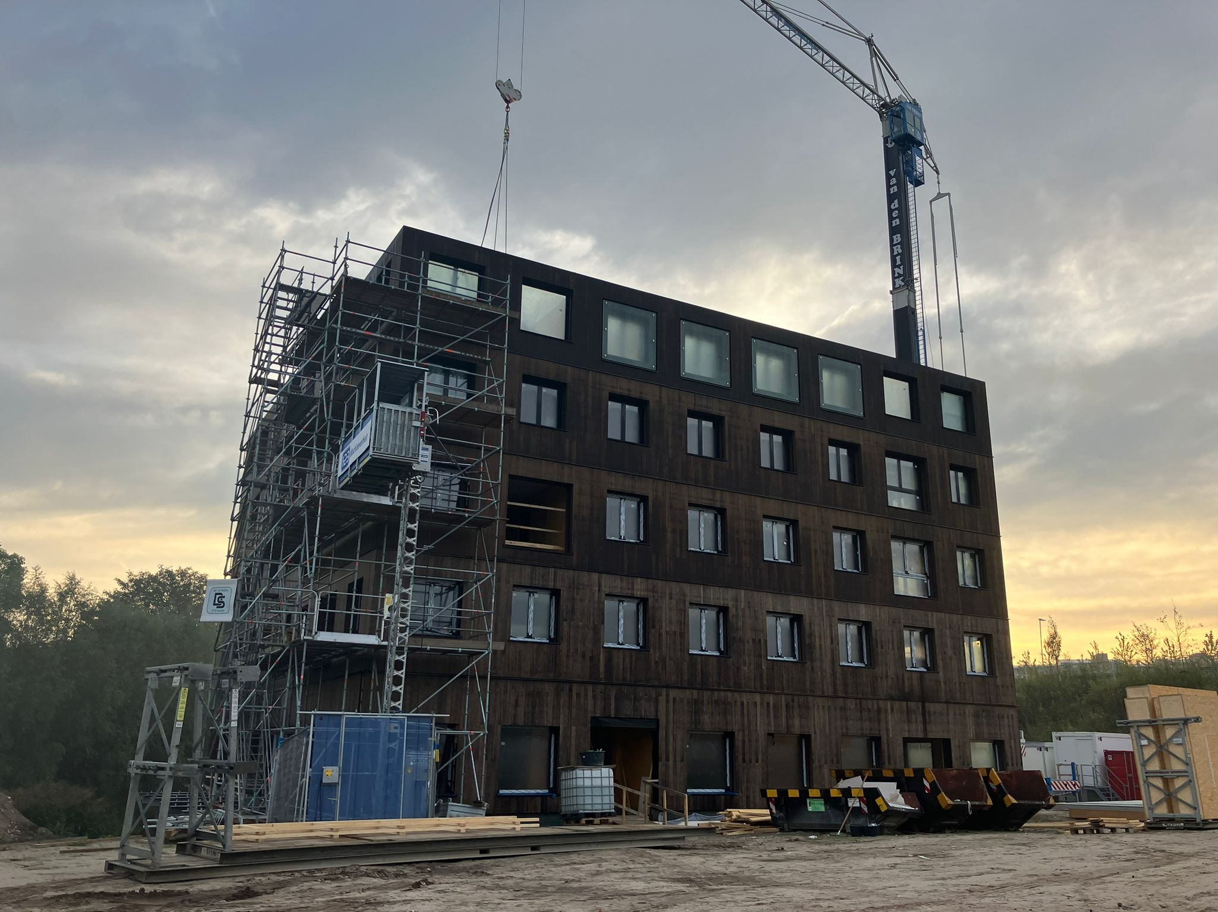
Results Switi Amsterdam
Cross laminated timber (CLT)
Switi, located in Amsterdam, Zuid-Oost, consists of a mid-rise apartment building (8 stories), and various single-family homes. Built entirely with pre-fab CLT.
Expected dates: June 2023 – November 2023.

Slide 28
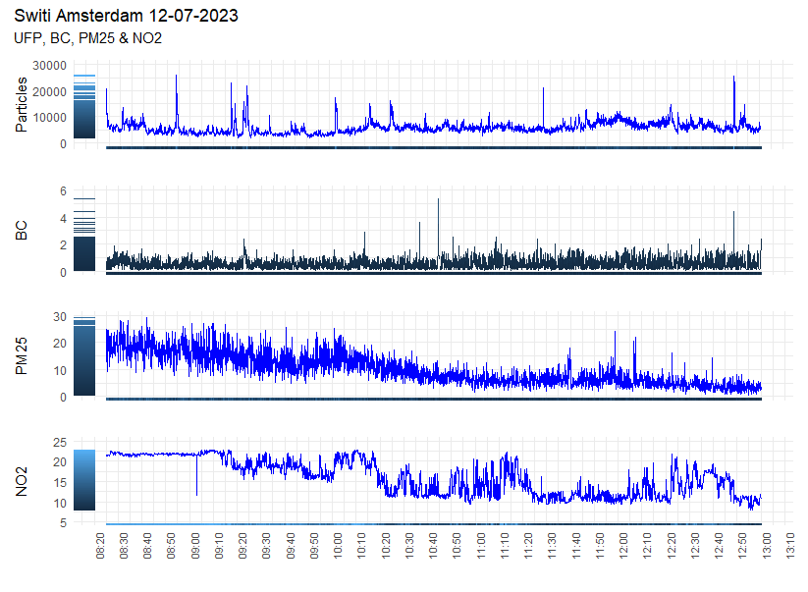
12-July-2023 - Switi
Location: Switi, Amsterdam
Wind: 4, W/S-W
Temp: 22
Instrument: DST, DST2, Partector 2, CS
Plot: UFP, BC, PM25, NO2
Activities: …
Activity level: Medium
Notes:
Calibration: Take “rf_CS4” and export it. Then run it on the data of switi.

Slide 29
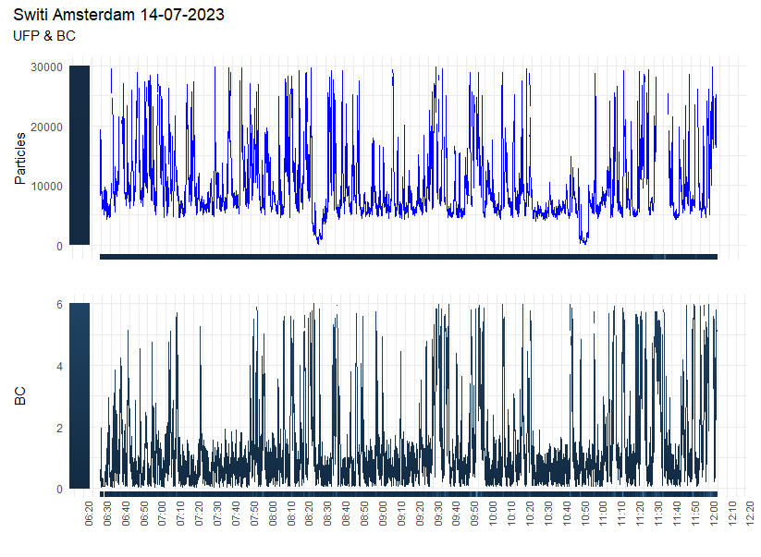
14-July-2023 - Switi
Location: Switi, Amsterdam
Wind: Speed, S / S-W
Temp: 22
Instrument: DST, Partector 2
Plot: UFP, BC
Activities:
Activity level: High
Remarks: CS not working

Slide 30
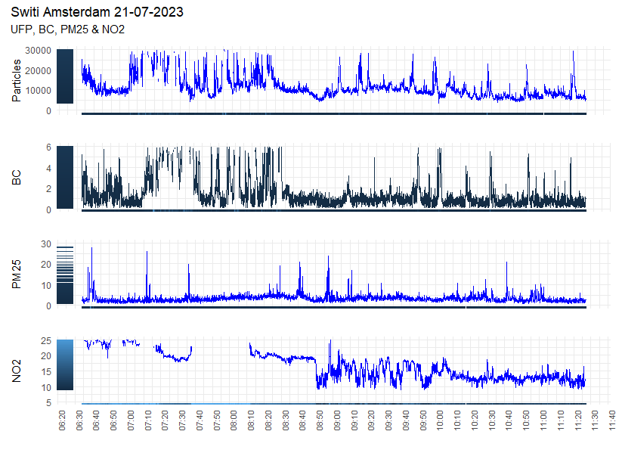
21-July-2023 - Switi
Location: Switi, Amsterdam
Wind: 1 / 2, S-E/ S-W
Temp: 22
Instrument: DST, Partector 2, CS
Plot: UFP, BC, PM25, NO2
Activities:
Activity level: Medium

Slide 31
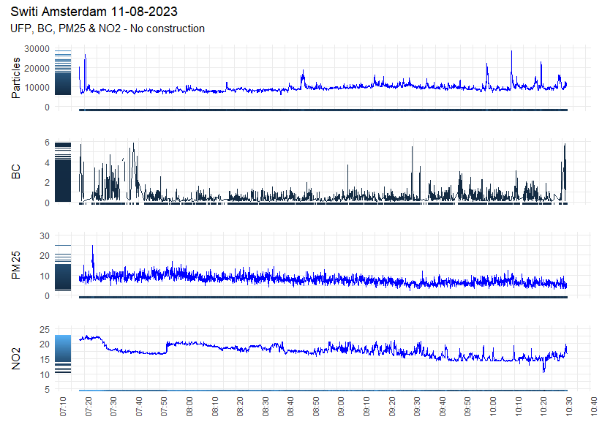
11-August-2023 – Switi - No Construction
Location: Switi, Amsterdam
Wind: 2, S-E
Temp: 27
Instrument: DST, Partector 2, CS
Plot: PM25, NO2, UFP, BC
Activities:
Activity level: No construction activity
Remarks: Off-site

Slide 32
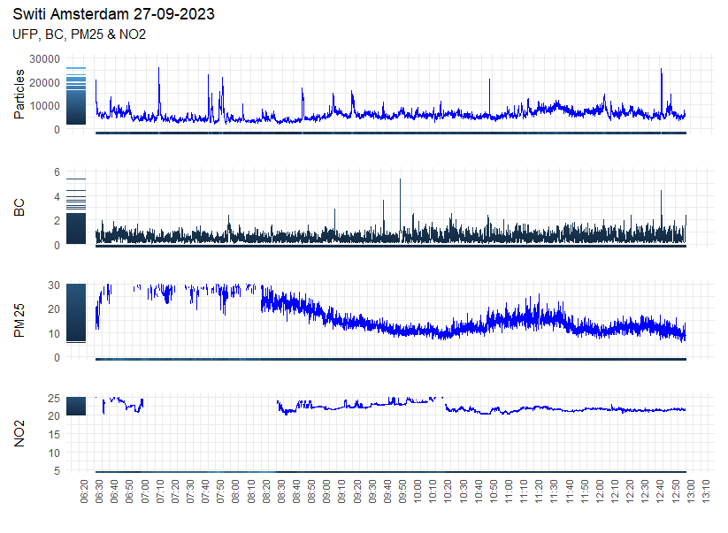
27-Sept-2023 - Switi
Location: Switi, Amsterdam
Wind:
Temp:
Instrument: DST, Partector 2, CS
Plot: PM25, NO2, UFP, BC
Activities:
Activity level: Medium to High

Slide 33
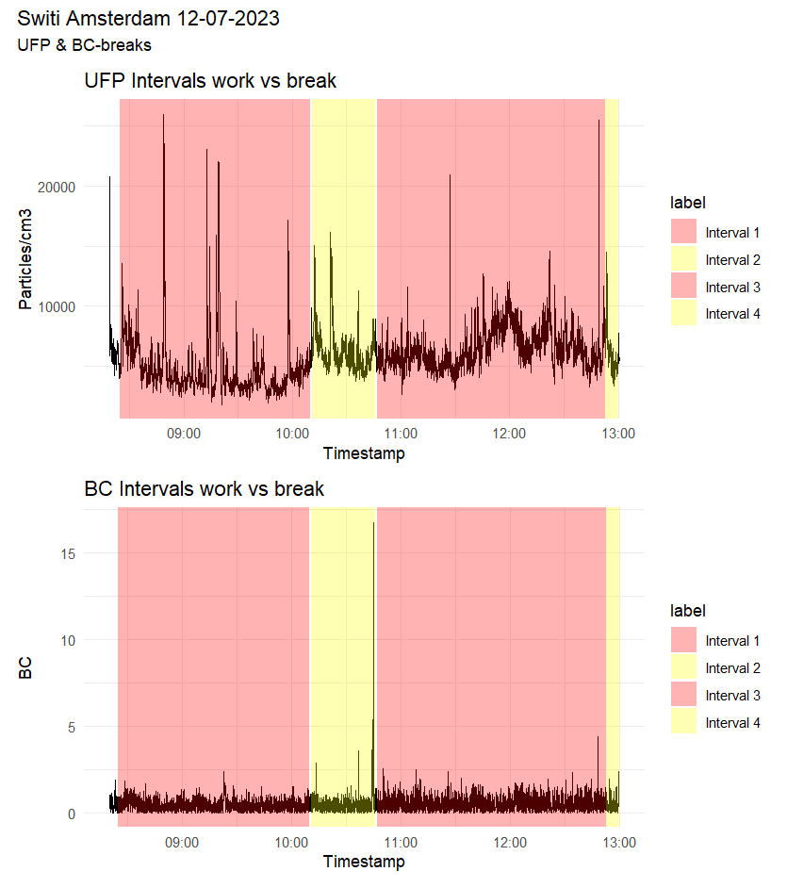
12-07-2023 – Switi – Breaks
 | Start | end | mean_value_UFP | mean_value_BC
1 | 2023-07-12 10:25:00 | 2023-07-12 12:10:00 | 4.790.500 | 0.4948694
2 | 2023-07-12 12:11:00 | 2023-07-12 12:46:00 | 6.281.705 | 0.5262021
3 | 2023-07-12 12:47:00 | 2023-07-12 14:53:00 | 6.533.547 | 0.6013600
4 | 2023-07-12 14:53:00 | 2023-07-12 15:00:00 | 6.004.886 | 0.6721945

Slide 34
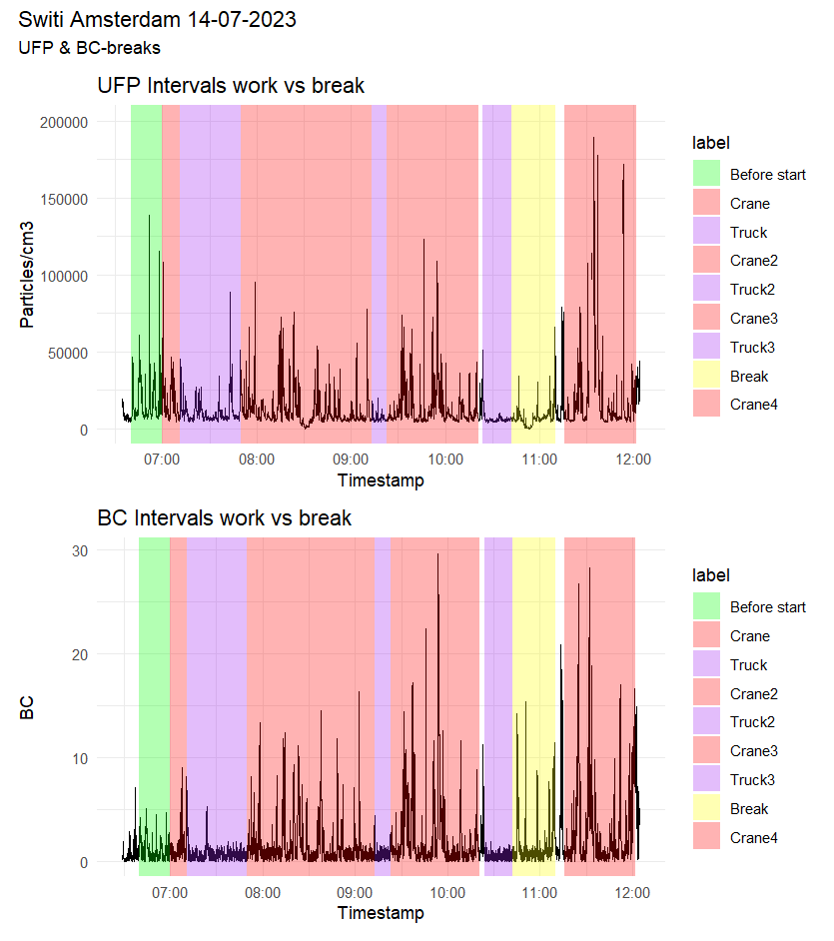
14-July-2023 – Switi - Breaks
 | start | end | mean_value_UFP | mean_value_BC
1 | 2023-07-14 08:40:00 | 2023-07-14 09:00:00 | 17.873.691 | 11.550.013
2 | 2023-07-14 09:00:00 | 2023-07-14 09:11:00 | 16.152.006 | 14.200.987
3 | 2023-07-14 09:11:00 | 2023-07-14 09:50:00 | 11.439.133 | 0.7564675
4 | 2023-07-14 09:50:00 | 2023-07-14 11:13:00 | 12.038.872 | 16.474.942
5 | 2023-07-14 11:13:00 | 2023-07-14 11:23:00 | 7.141.642 | 0.8033327
6 | 2023-07-14 11:23:00 | 2023-07-14 12:21:00 | 13.351.480 | 24.489.664
7 | 2023-07-14 12:24:00 | 2023-07-14 12:42:00 | 6.169.240 | 0.6112649
8 | 2023-07-14 12:42:00 | 2023-07-14 13:10:00 | 7.589.375 | 18.984.045
9 | 2023-07-14 13:16:00 | 2023-07-14 14:02:00 | 82.984.793 | 32.791.042

Slide 35
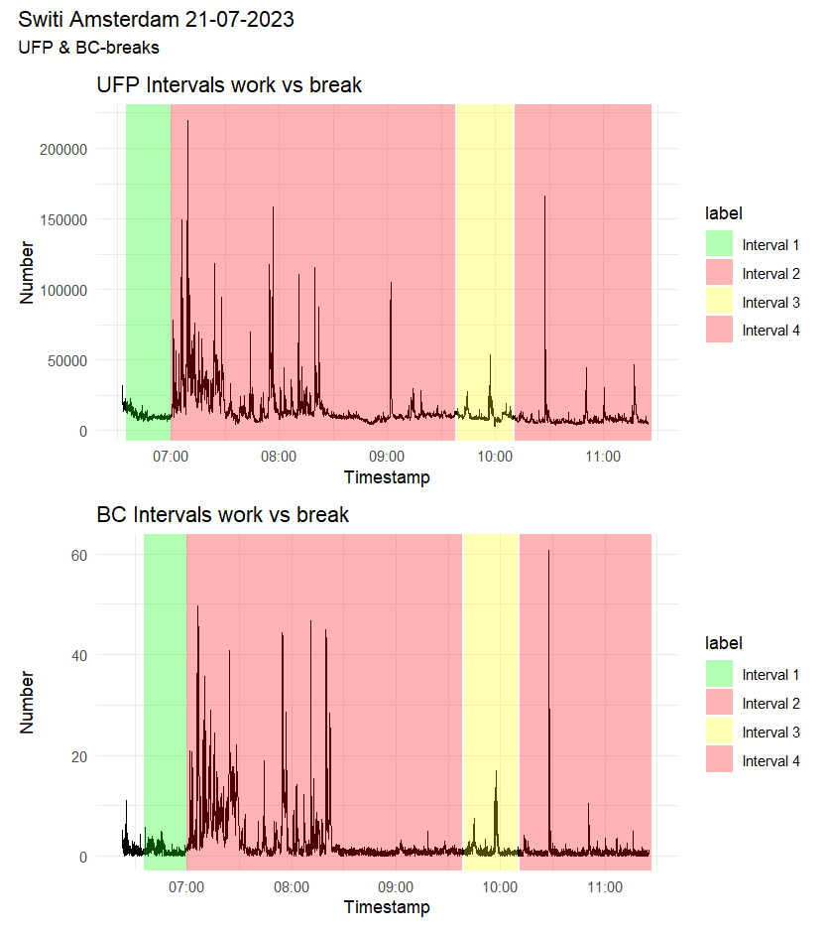
21-July-2023 – Switi
- Breaks
 | start | end | mean_value_UFP | mean_value_BC
1 | 2023-07-21 08:35:00 | 2023-07-21 09:00:00 | 10.778.024 | 1.202.326
2 | 2023-07-21 09:00:00 | 2023-07-21 11:38:00 | 17.725.008 | 3.653.979
3 | 2023-07-21 11:39:00 | 2023-07-21 12:10:00 | 10.956.877 | 1.461.984
4 | 2023-07-21 12:11:00 | 2023-07-21 13:27:00 | 8.107.385 | 1.036.569

Slide 36
27-Sept-2023 – Switi - Breaks

Slide 37
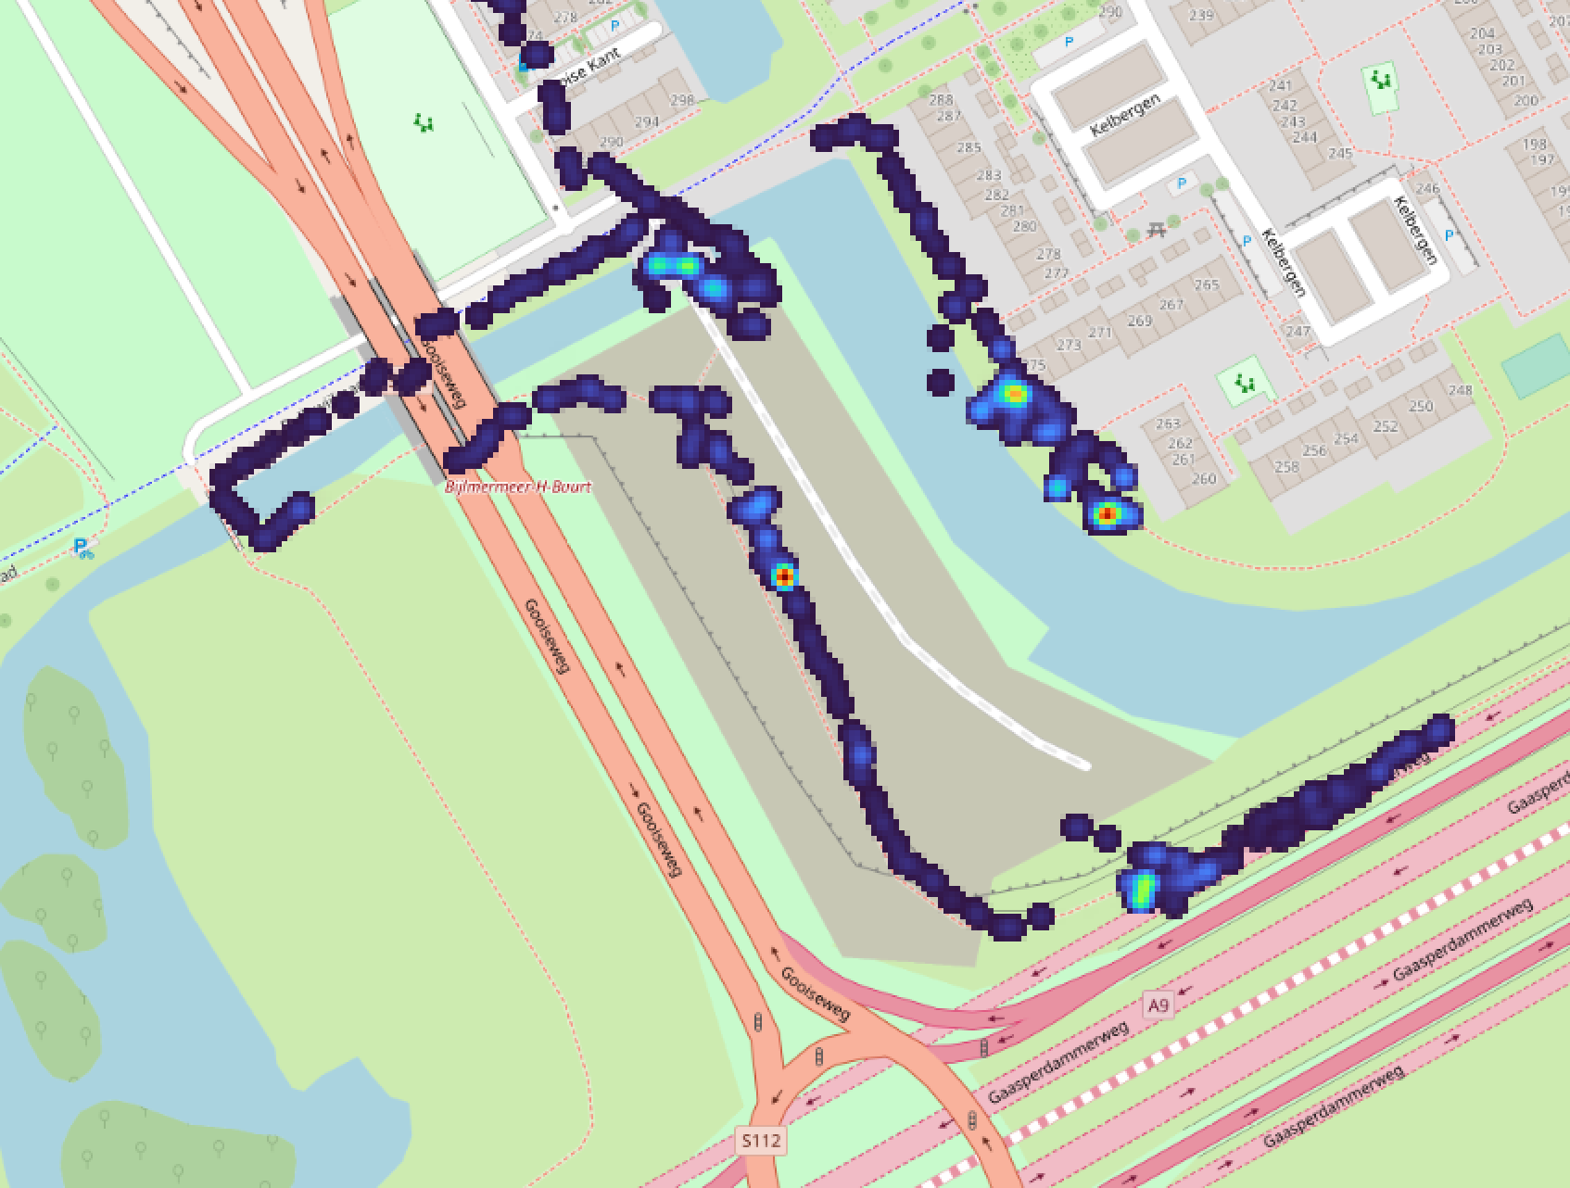
Instrument: DST, DST2, Partector 2
Date: 28-Jube-2023
Plot: BC+number UFP
Location: Switi, Amsterdam
Wind: 3 m/s, SW
Temp: 19ºC
1
4
Locations we explored:
Entrance. -> Far from the current construction process
Location currently closest to cranes. Upwind at time of measurement
Next to the highway, on a bridge a bit above the site. Closest to generator.
Downwind at time of measurement, but far away due to water.
Current/first part they will be building (yellow is the entire building plot)
2
5
3

Slide 38
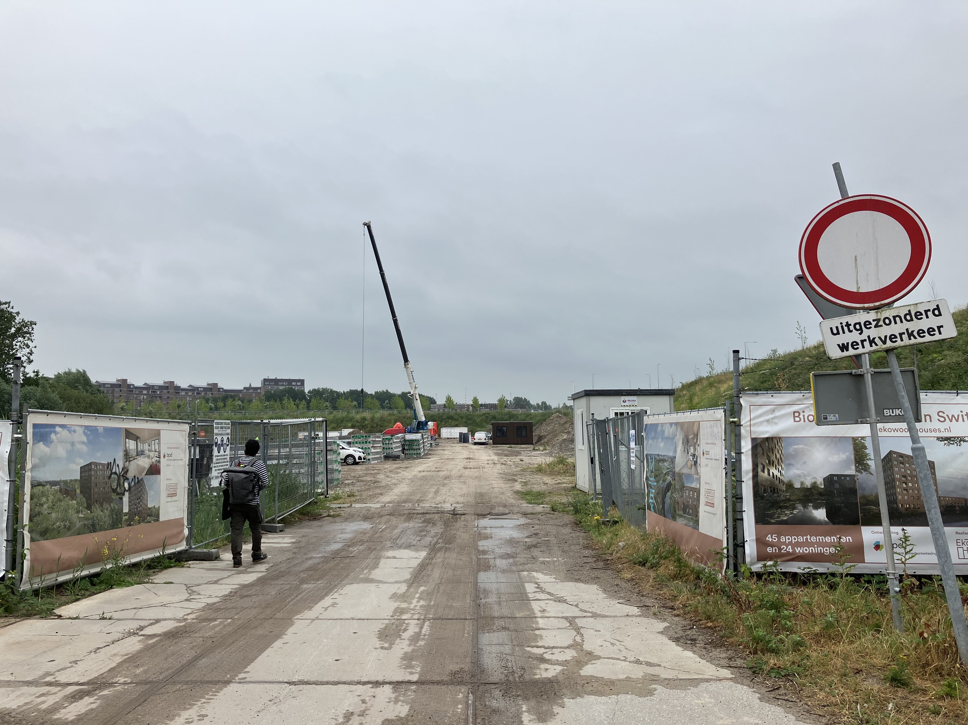
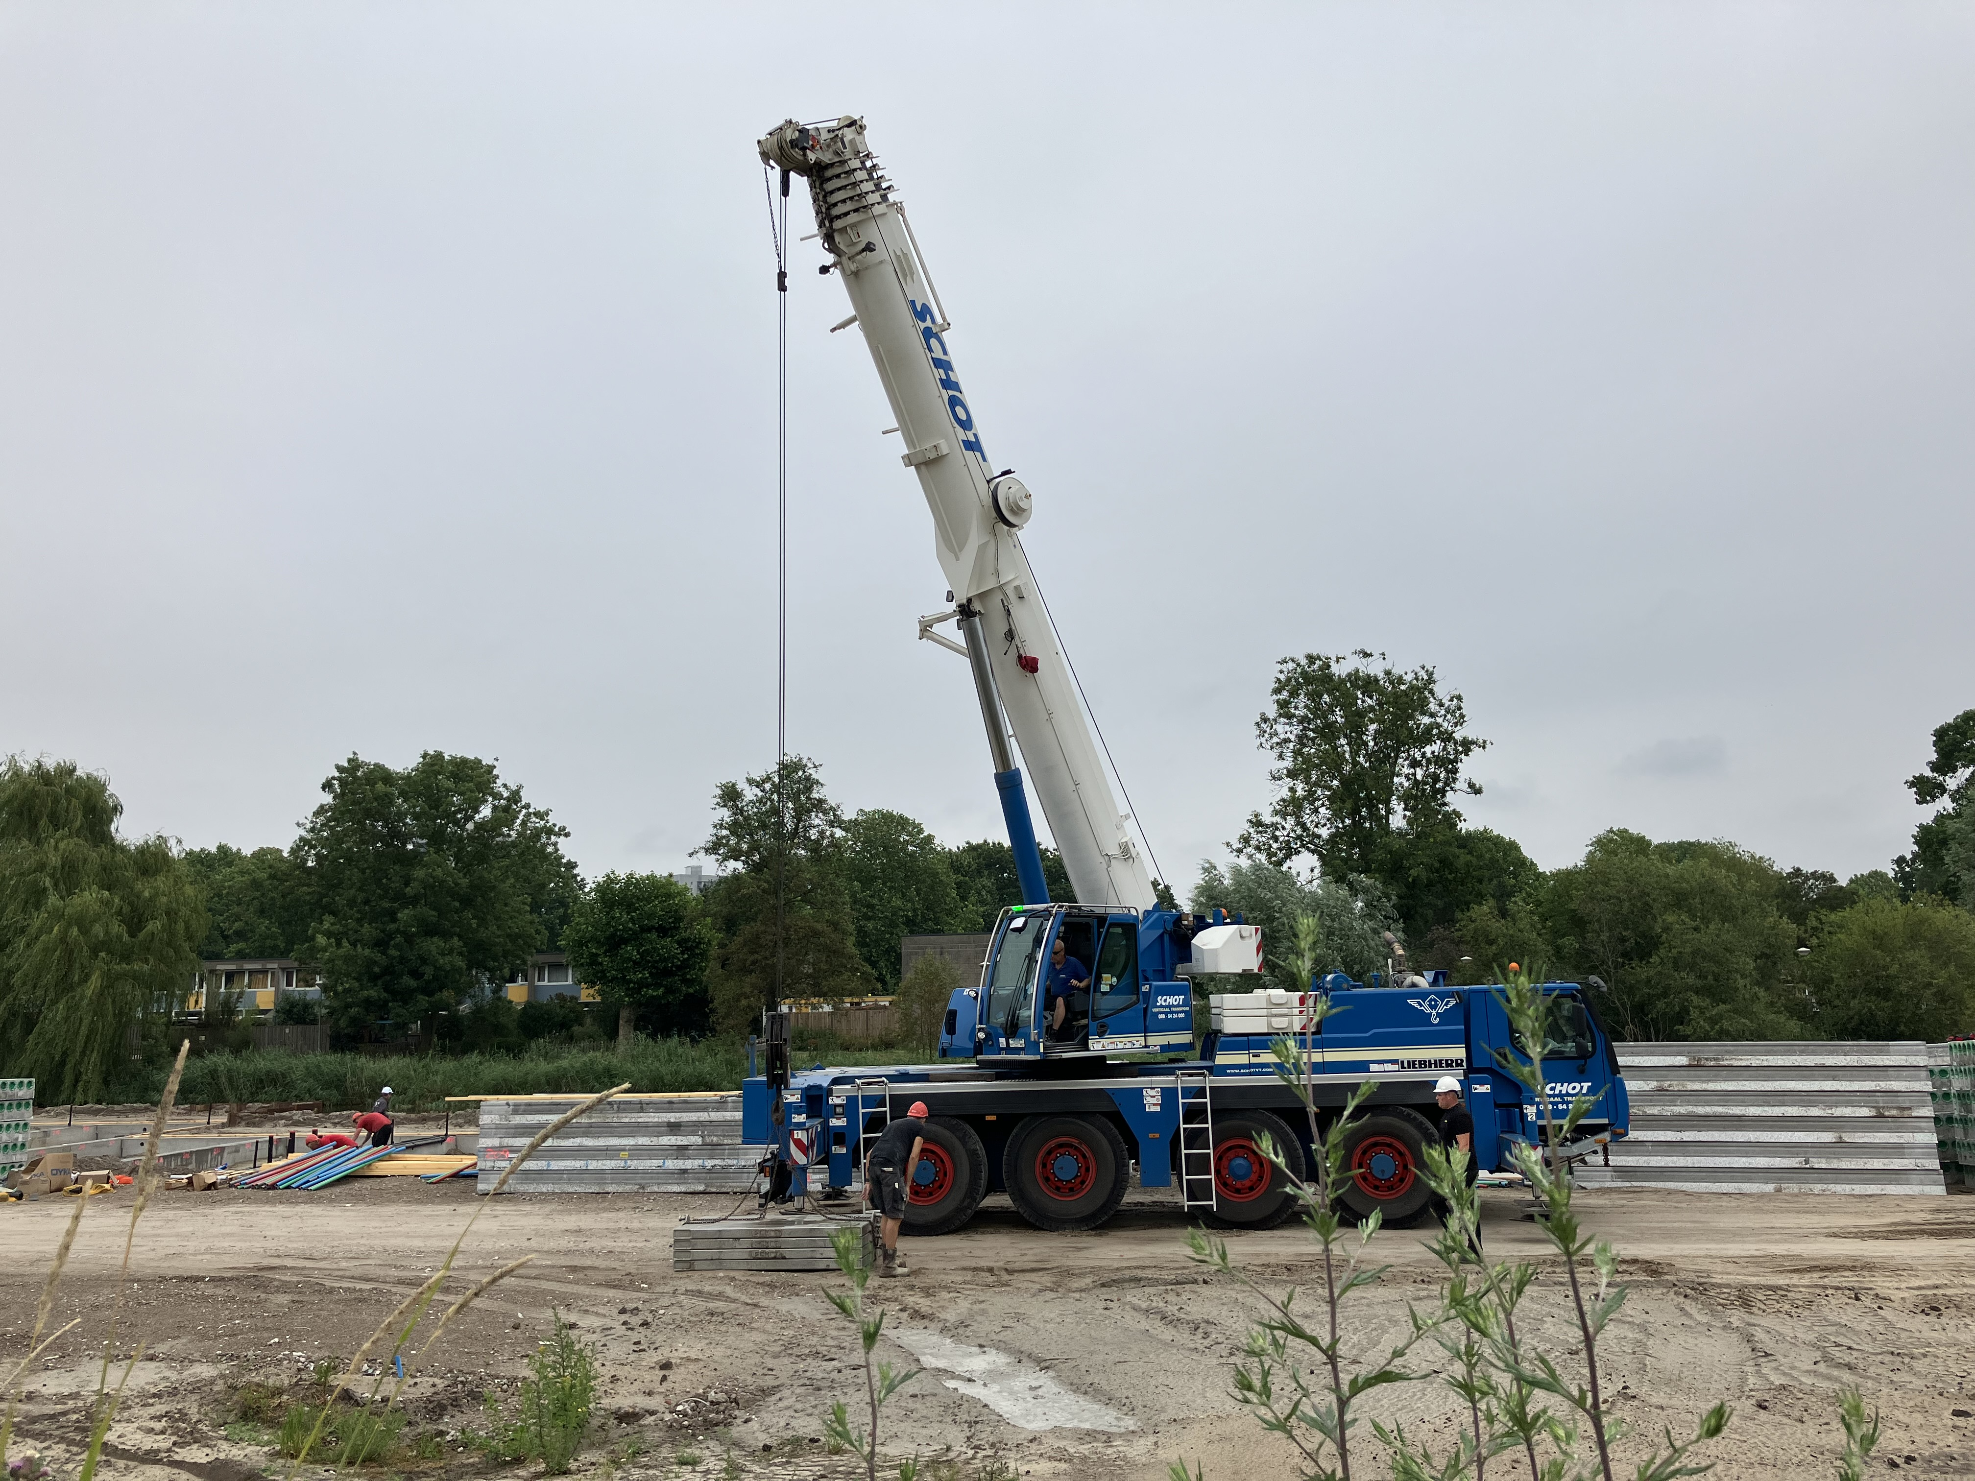
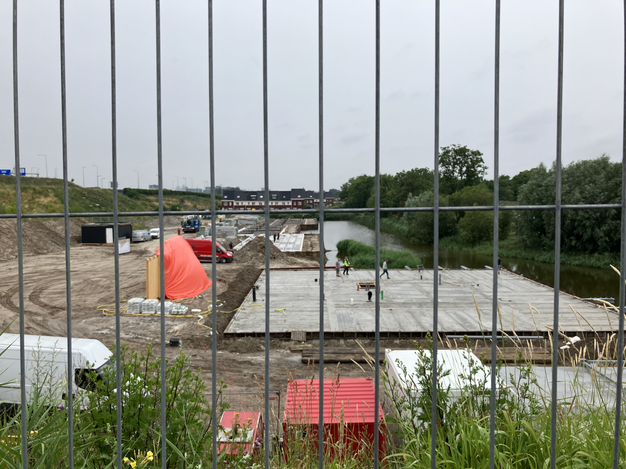
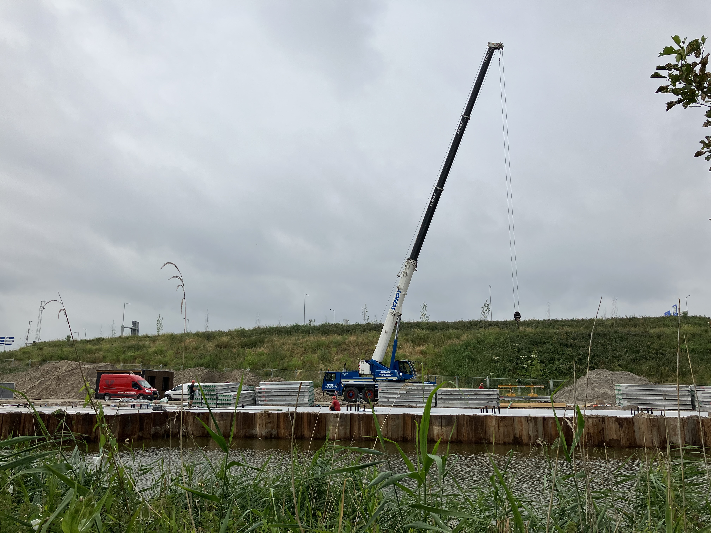
1
2
Pictures site
3
4

Slide 39
To do:
Overviews Switi – check 27 sept and 12 august (23-10-2023)
Add averages in numbers, make table (23-10-2023)
Pauze analysis (23-10-2023)
Share data with Titus (23-10-2023)
Peaks analysis, add timings?
Write a report
5. Add extra calibration slides
6. Add measuring locations map, QGIS

